Slide 1
Photomicrographs of Plant foods
Bean: Black
Permission to reproduce original photomicrographs used to make this collection may be obtained from
Dr. David O. Norris at
david.norris@colorado.edu

Slide 2
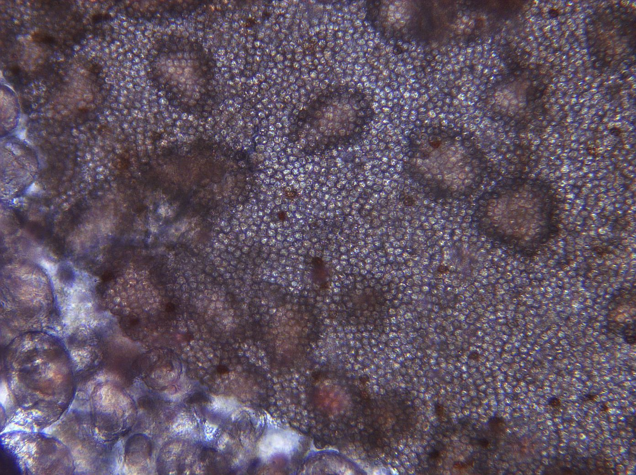
Notes:
37. Phaseolus vulgaris L. Bean, black. Seed coat (testa) with pulp cells adhering to underside (arrows). 10X

Slide 3
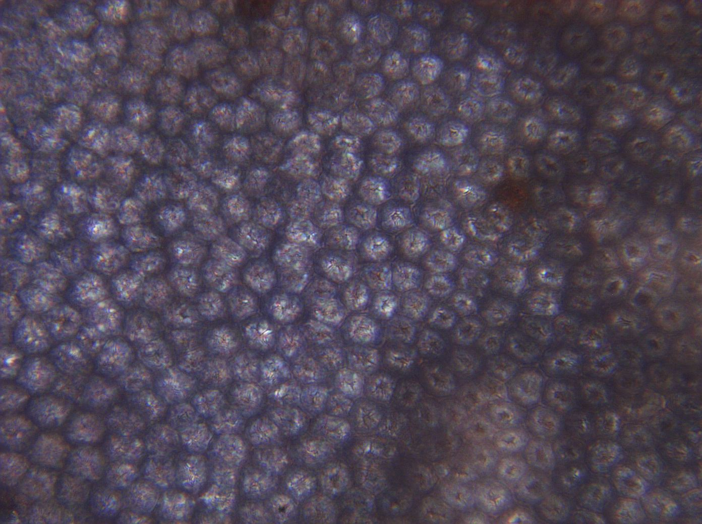
Notes:
38. Bean, black; seed coat 40X

Slide 4
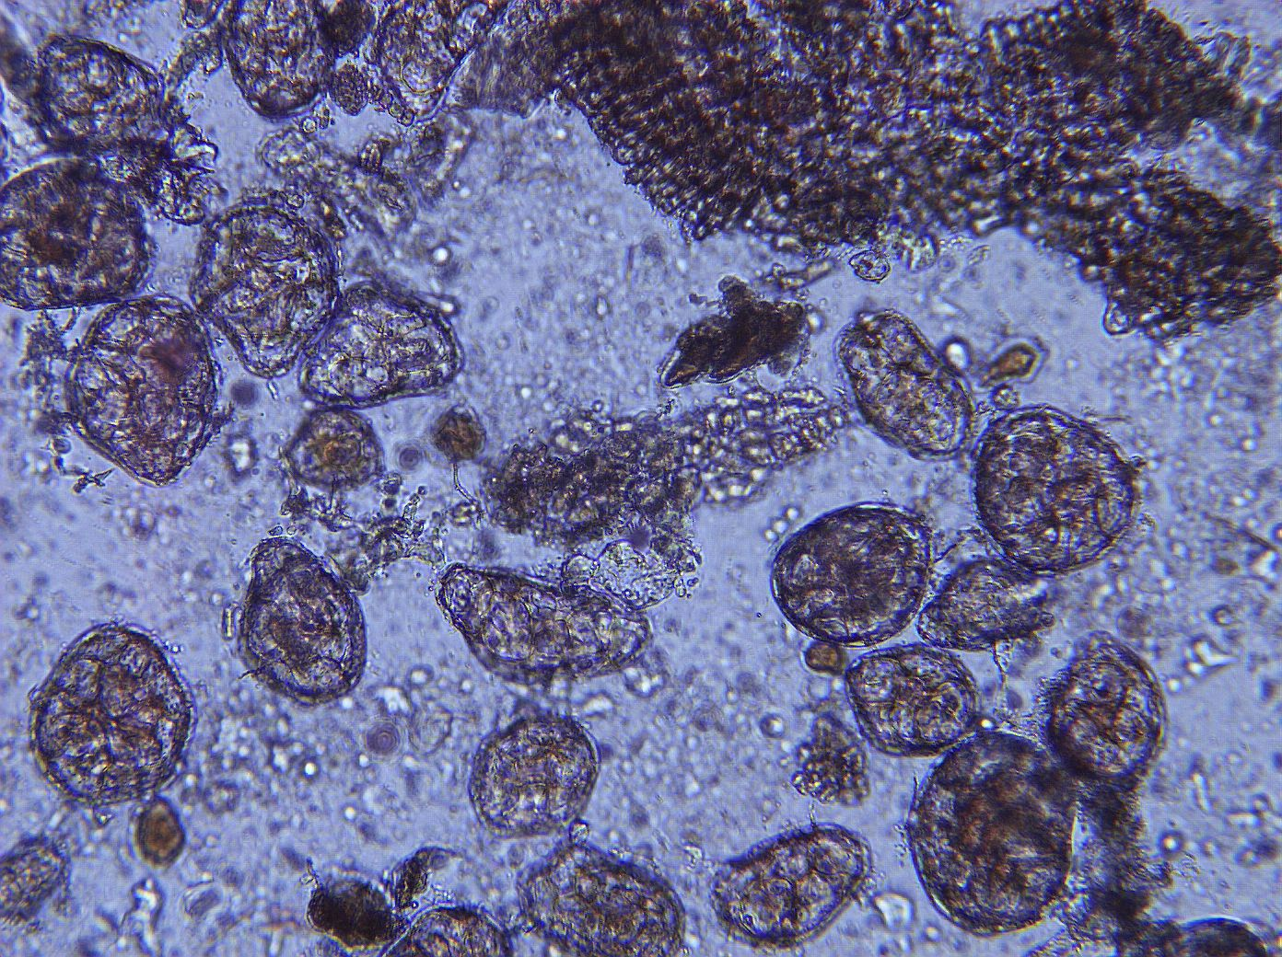
Notes:
39. Bean, black. Pulp parenchymal cells, 10X

Slide 5
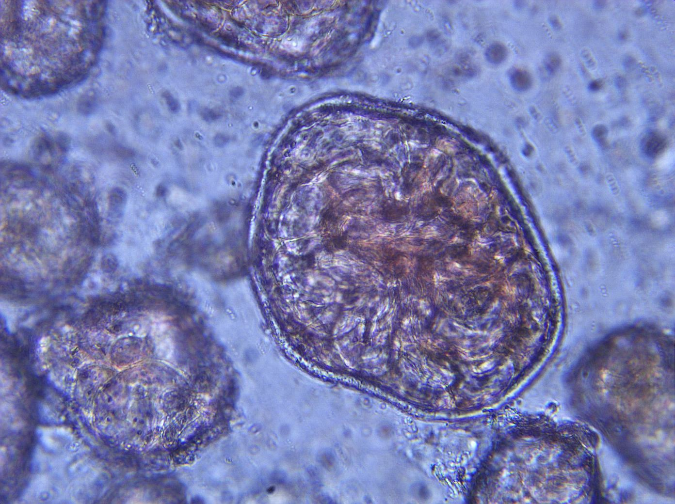
Notes:
40. Bean, black. Pulp parenchymal cells, 25X.

